Slide 1
Loan Management System using MySQL

Slide 2
MySQL
What is MySQL?
MySQL is an open-source relational database management system (RDBMS) developed by MySQL AB, now owned by Oracle Corporation.
It is one of the most popular databases used globally, especially for web applications.
Known for its speed, reliability, and ease of use, MySQL supports large-scale databases (millions of rows) and is highly customizable.
Key Features:
Open-source: Free to use and distribute, with a vast developer community.
Cross-platform: Available on various operating systems (Windows, macOS, Linux).
Basic Concepts
Database: Organized collection of data.
Table: Collection of rows and columns (records and fields).
Schema: The structure that defines the database (tables, views, etc.).

Slide 3
SQL Commands Overview
Data Definition Language (DDL): Commands that define the structure of a database.
CREATE: Create new databases, tables.
ALTER: Modify structure of existing tables.
DROP: Delete tables or databases.
Data Manipulation Language (DML): Used to manipulate the data inside tables.
INSERT: Add new records to a table.
UPDATE: Modify existing data.
DELETE: Remove records.
SELECT: Retrieve data from a table.

Slide 4
Basic Query Example
SELECT Statement:
SELECT column1, column2 FROM table_name WHERE condition;
Example: Fetch Names from Customer Table.
SELECT name FROM customers WHERE city = 'New York’;
Filtering with WHERE Clause:
Operators: =, >, <, >=, <=, <>
Combine filters with AND, OR, NOT.
Aggregate Functions:
Used to summarize data.
COUNT(), SUM(), AVG(), MAX(), MIN()

Slide 5
Constraints
PRIMARY KEY: Unique identifier for each record.
FOREIGN KEY: Links two tables.
NOT NULL: Ensures a column cannot have a NULL value.
UNIQUE: Ensures all values in a column are different.
Sorting Results: ORDER BY
Syntax:
SELECT column1, column2 FROM table_name ORDER BY column1 ASC|DESC;
Default Sorting is Ascending (ASC).

Slide 6
PROJECT
Loan Management System
Project Summary:
The Loan Management System project is designed to manage and automate various aspects of loan processing and customer data management. By working with key datasets and applying criteria-based classifications, triggers, and stored procedures, this system efficiently handles loan applications, customer statuses, and interest calculations.
Objective:
The project aims to:
Analyze customer income status to categorize customers based on their financial standing.
Calculate loan amounts, monthly and annual interest, and update customer CIBIL scores.
Automate the loan approval process by using triggers for real-time status updates and by filtering customers based on defined criteria.

Slide 7
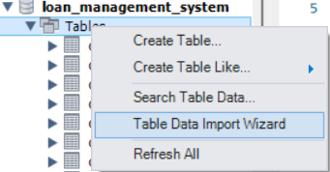
Customer Income Status Analysis
Import the Customer Income table containing applicant income data to the database.
Customers are categorized into different grades based on the following criteria:
Grade A: Applicant income > 15,000
Grade B: Applicant income > 9,000
Middle Class: Applicant income > 5,000
Low Class: Applicant income ≤ 5,000
After categorization, create a new table called Customer Income Status which stores the categorized income data. This table is then used for further calculations and analysis in the project.

Slide 8
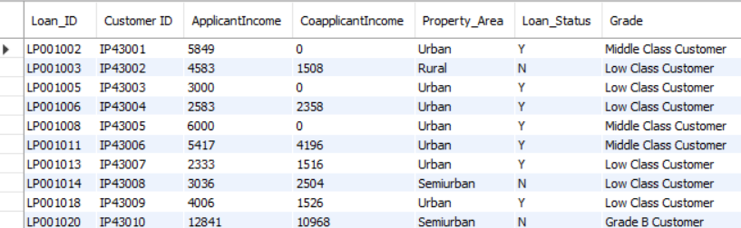
Customer Income Status Analysis
create table customer_income_status
select *, case when applicantincome > 15000 then "Grade A Customer“
when applicantincome > 9000 then "Grade B Customer“
when applicantincome > 5000 then "Middle Class Customer“
else "Low Class Customer"end as Grade from customer_income;

Slide 9
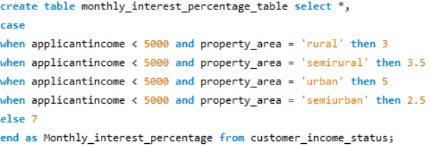
Monthly Interest Percentage Calculation
Based on the applicant's income and their property area (urban, rural, semi-rural, etc.), the system applies different interest rates:
Rural → 3%
Semi-rural → 3.5%
Urban → 5%
Semi-urban → 2.5%
Otherwise → 7%

Slide 10
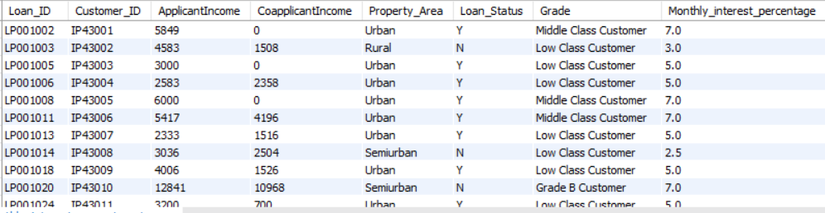

Slide 11
Trigger
What is a Trigger?
A trigger is a special type of stored procedure in a database that automatically executes in response to specific events on a table, such as inserts, updates, or deletes.
Types of Triggers:
Row-Level Triggers: Executes once for each row affected by the event (e.g., updating each row’s loan status).
Statement-Level Triggers: Executes once per statement, regardless of the number of rows affected (e.g., updating the CIBIL score status).
Why Use Triggers?
Automation: Automatically perform actions, such as validating or modifying data when certain conditions are met.
Data Integrity: Enforce business rules and ensure data consistency within the database.

Slide 12
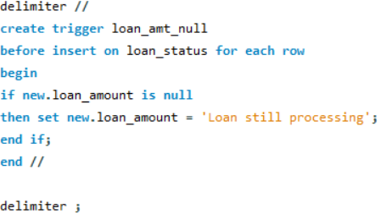
Loan Status Updates and CIBIL Score Management
The system manages loan processing and CIBIL score status through a set of triggers:
A row-level trigger ensures that if the loan amount is not yet assigned (null), the status is automatically set to "Loan Still Processing.“
Note: The table should be created manually for triggers.

Slide 13
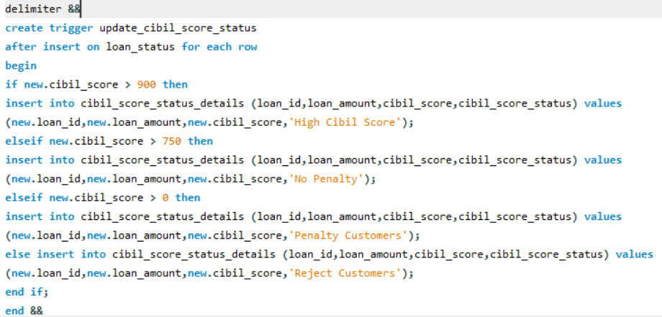
A statement-level trigger updates customers' CIBIL scores and categorizes them:
High CIBIL score: Above 900.
No penalty: CIBIL score above 750.
Penalty customers: CIBIL score above 0 but below 750.
Reject customers: CIBIL score 0 or less; these customers are not eligible to apply for a loan.

Slide 14

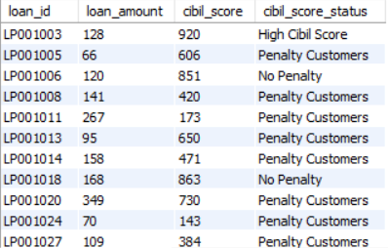
After classification, customers with rejected loan applications or those still in the "processing" stage are deleted to ensure data cleanliness.
The final CIBIL score updates, including the loan amount (converted to integers), are stored in a new table named Loan CIBIL Score Status Details.

Slide 15
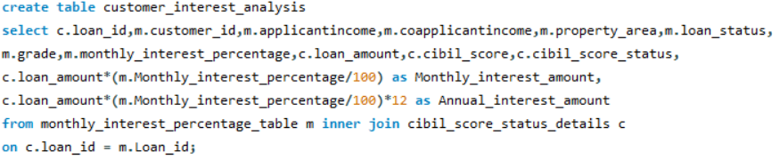
Customer Interest Analysis
Calculate Monthly and Annual Interest Amount
Use the monthly interest percentage and the loan amount to calculate:
Monthly Interest Amount = (Loan Amount * Monthly Interest Percentage) / 100
Annual Interest Amount = Monthly Interest Amount * 12
Join the Customer Interest Analysis table with the CIBIL Score Status Details table to bring together loan, interest, and CIBIL score data for further analysis.

Slide 16
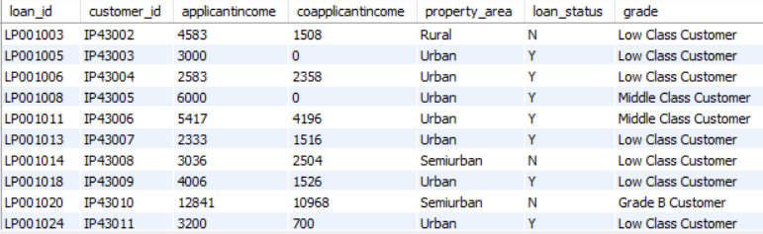
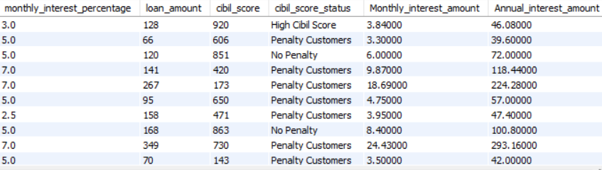

Slide 17

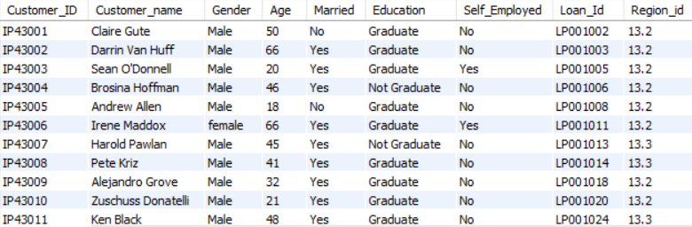
Customer Information Update
The Customer Info dataset is imported to the system, where the project updates the gender and age of customers based on their customer_id. This ensures that the data remains up-to-date and accurate for analysis and reporting.

Slide 18
Joins in SQL
What is a Join?
A join is an SQL operation that combines rows from two or more tables based on a related column between them. Joins are essential for retrieving related data across multiple tables in a relational database.
Types of Joins:
Inner Join: Returns rows with matching values in both tables.
Left Join: Returns all rows from the left table and matched rows from the right. Unmatched rows return NULL for the right table.
Right Join: Returns all rows from the right table and matched rows from the left. Unmatched rows return NULL for the left table.
Full Join: Returns all rows when there is a match in either table. Unmatched rows return NULLs.

Slide 19
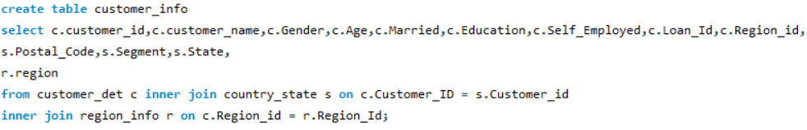
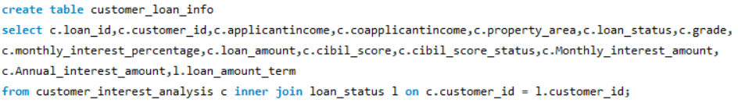
Joining all 5 tables
The project joins all datasets (Customer_interest_analysis, cibil_score_Status, Customer_det, Country_state, and Region tables) without repeating any fields. This creates a unified view of the data and allows the system to perform additional analysis.
Joining 3 tables using INNER JOIN and creating it as a new table – (customer_info).
Joining 2 tables using INNER JOIN and creating it as a new table – (customer_loan_info).

Slide 20
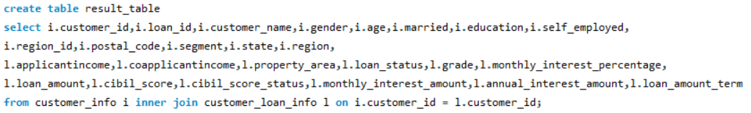
Joining customer_info and customer_loan_info using INNER JOIN and creating it as a new table – (result_table).
Finding the Mismatched details from country_state and region tables using RIGHT JOIN:

Slide 21
Stored Procedure
What is a Stored Procedure?
A stored procedure is a precompiled collection of one or more SQL statements stored in the database. It can be executed as a single call, encapsulating complex logic and enhancing performance.
Key Benefits:
Reusability: Stored procedures can be reused across multiple applications and queries.
Maintainability: Changes to the logic can be made in one place, without altering application code.
Performance: Precompilation can improve execution speed, as the database server optimizes the execution plan.
Syntax:
CREATE PROCEDURE procedure_name
[ (parameter1 datatype, parameter2 datatype, ...) ]
AS
BEGIN
-- SQL statements
[ RETURN; ]
END;

Slide 22
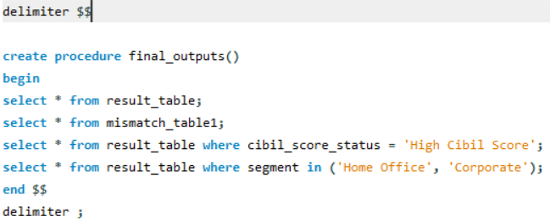
Final Outputs
All the analysis outputs (such as mismatch detection, high CIBIL score, etc.) are stored as procedures in the database. This allows the system to perform quick lookups and automated processing for future queries and loan approvals.

Slide 23
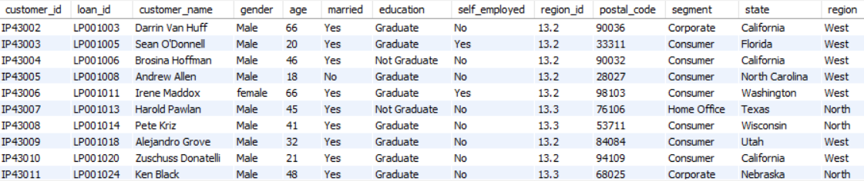
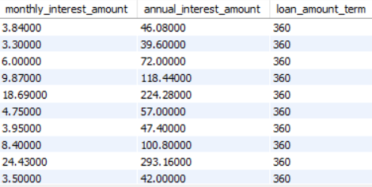
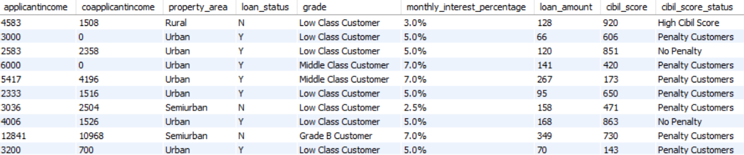
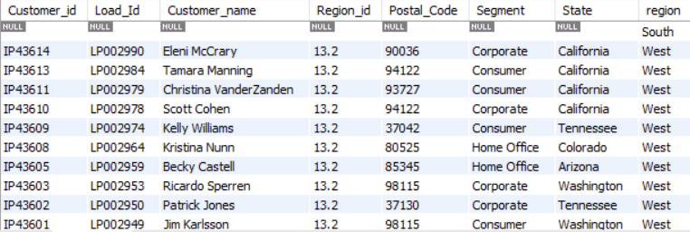
Output 1:
Output 2:

Slide 24
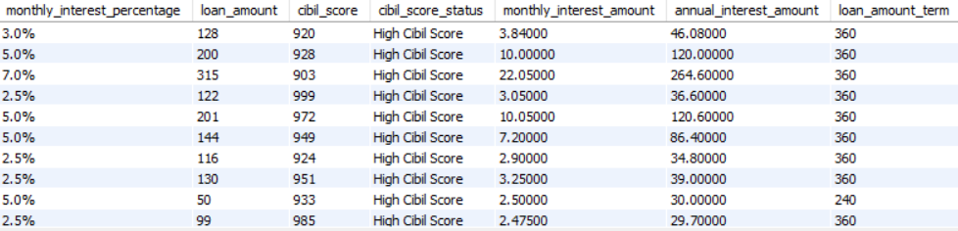
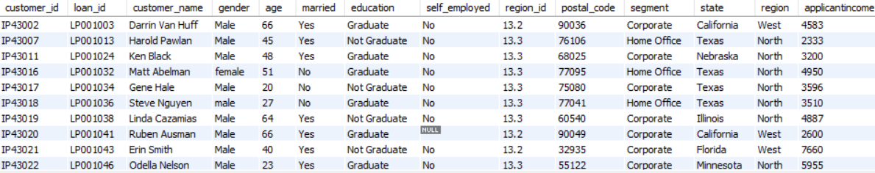
Output 3:
Output 4:

Slide 25
Conclusion:
This Loan Management System project brings together different datasets and business rules to streamline loan management. By automating the classification of customers, updating CIBIL score statuses, and calculating loan interest amounts, the system provides a comprehensive approach to managing loans and customer data efficiently.
Thank You.

